Slide 1
PA1 Part1 Introduction
2016 Fall COSI 131A

Slide 2
Unix Command Line Demo
ls
cd
pwd
head
grep
wc
>

Slide 3
Unix Piping
head file1.txt | grep keyword | wc

Slide 4
Unix Output Redirection
head -15 num_file.txt > smaller_file.txt

Slide 5
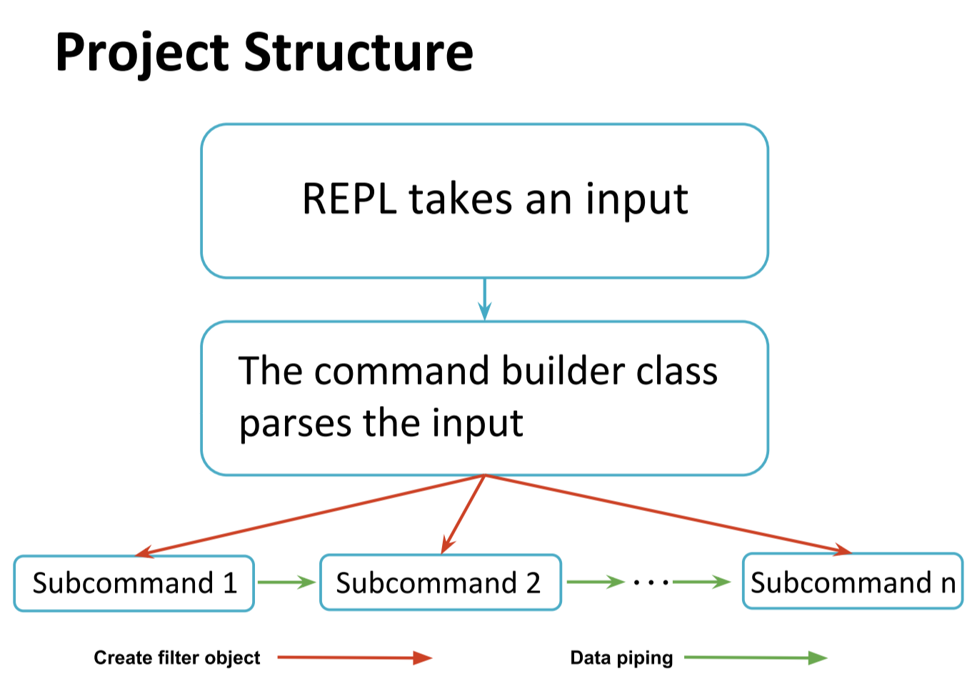
What is REPL?
Loop
Run only if syntax is correct

Slide 6
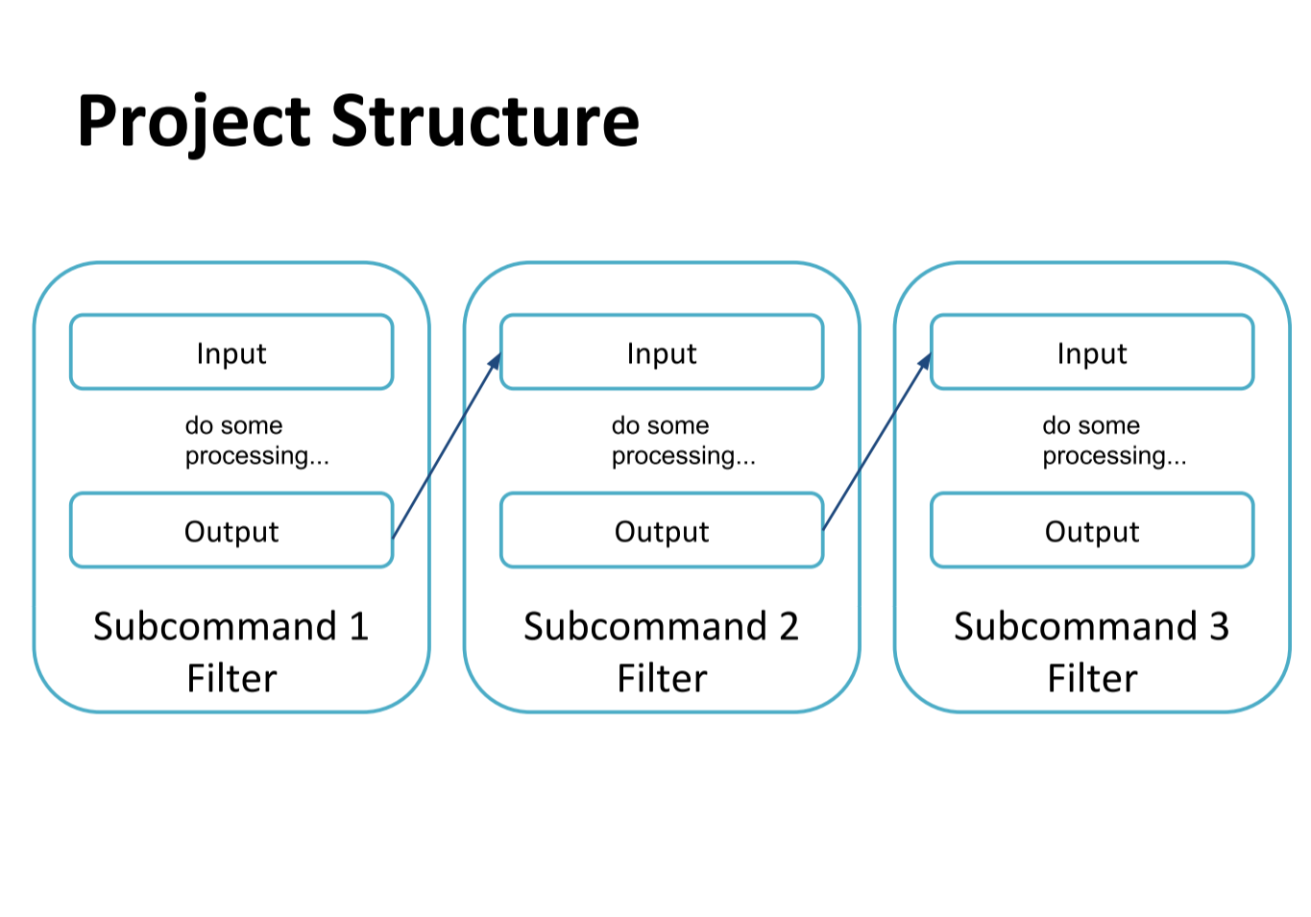

Slide 7
Example
head foo.txt | grep fool | wc > out
This command will generate 3 subcommands and they will be processed in 3 independent filters (as for part 1, SequentialFilters):
1 filter for head
1 filter for grep
1 filter for wc

Slide 8
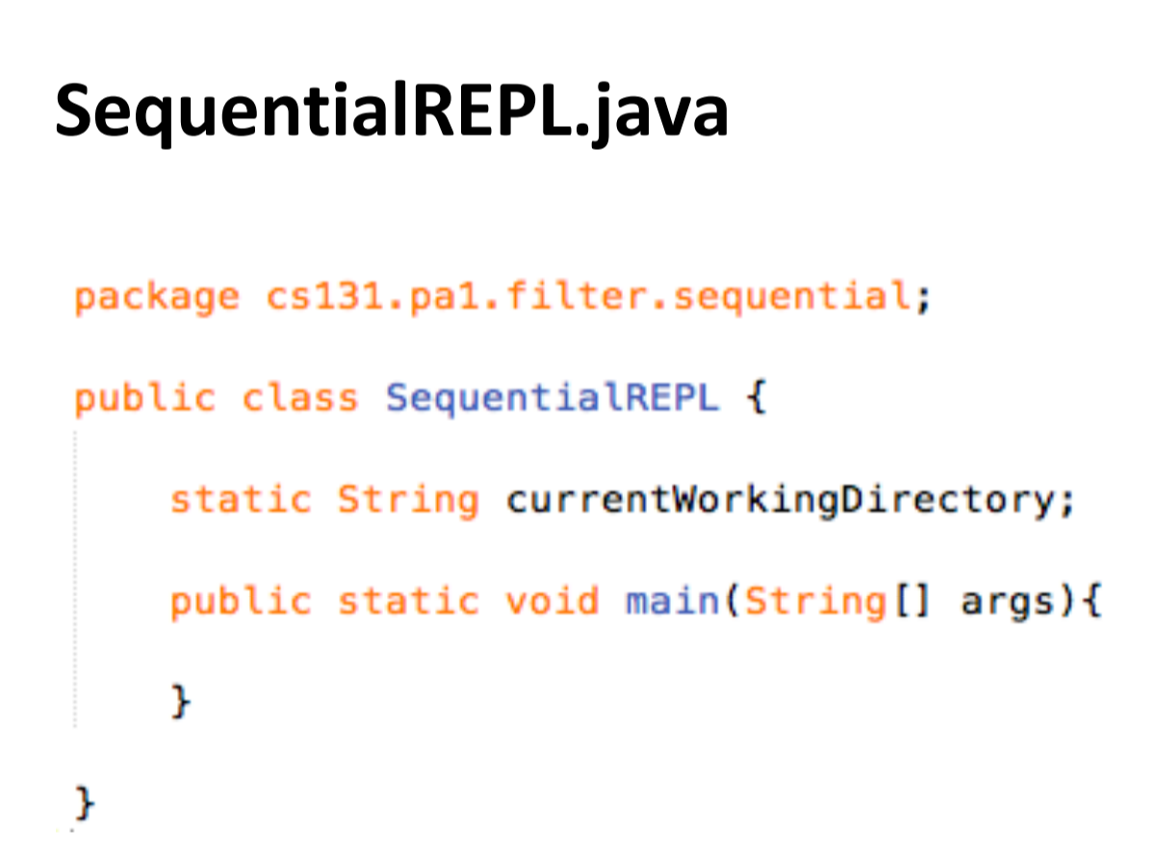

Slide 9
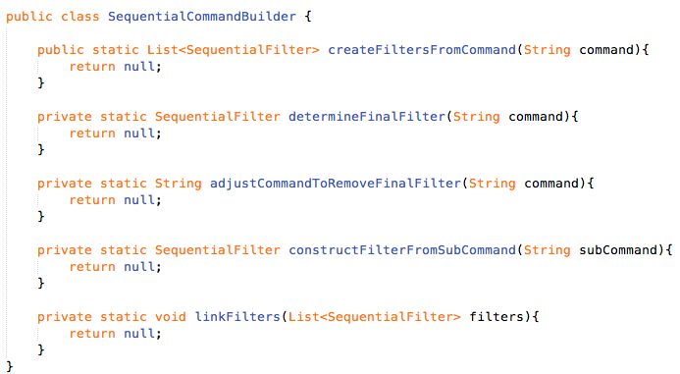
SequentialCommandBuilder.java

Slide 10
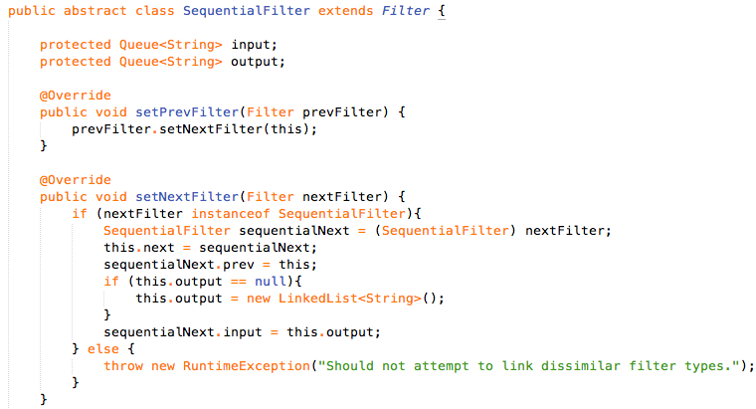
SequentialFilter.java
…

Slide 11
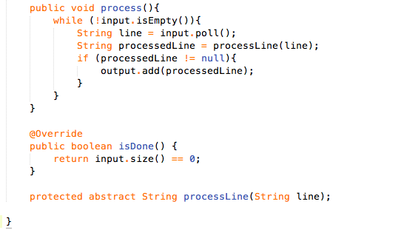
SequentialFilter.java
…

Slide 12
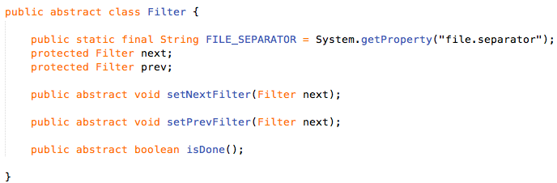
Filter.java

Slide 13
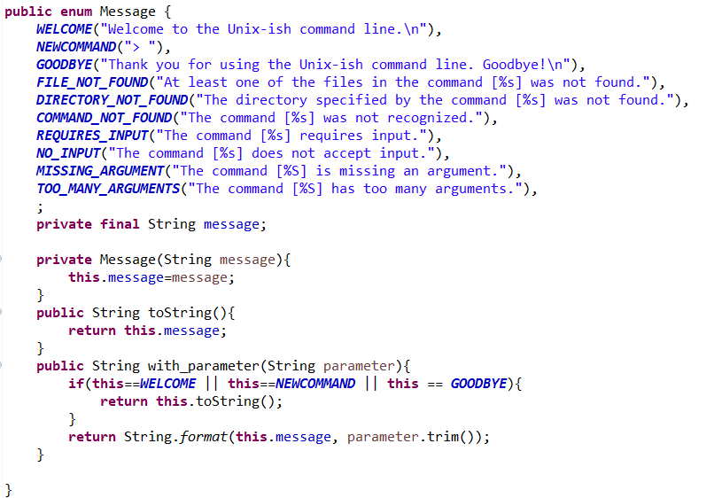
Message.java

Slide 14
Unit testing
JUnit framework (used for integration tests) Using with Eclipse
We have provided you with expected behavior
Because of the nature of testing, string parity is essential. Use Message.java!

Slide 15
Unit testing
Add JUnit Library:
Right-click menu of the project > Properties > Java Build Path > Libraries tab > Add Library… > JUnit > JUnit library version: JUnit 4 > Finish (JUnit 3 will also work)
Run All tests:
Right-click AllSequentialTests.java which contains all tests > Run As > JUnit Test
Cannot run tests individually because they are integrated

Slide 16
Error Handling
Some error cases are obvious:
Unidentified commands
File/directory does not exist
Missing arguments
Piping order is a little bit less intuitive…
Where to start? Behavior expectation

Slide 17
General Advice
Start Early, post questions on forum, come to OH with specific Questions
Try to complete REPL, CommandBuilder, and head filter first since they are the main core of the integration tests.
Practice with UNIX to make sure your piping understanding is accurate.

